Slide 1
Deep Learning Based Human Emotion Recognition System From Facial Expressions
Supervisor:
Shaila Rahman
Assistant Professor
Dept. of CSE
External :
Dr. Bilkis Jamal Ferdosi
Professor
Dept. of CSE
Dhanonjoy Howlader – 18101062
Ratin Dev Shadhon – 18101059
Sararah Mahjabin – 18101067

Slide 2
Table of contents
01
02
03
04
Introduction
Applications
Lit Review
Proposal
05
06
07
08
Plans
Solution
Conclusion
References

Slide 3
1
Introduction

Slide 4



Introduction
Human Emotion is an interesting mixture of psychology and technology. One of the main approaches to the
recognition of emotions is the analysis of facial expressions. Basic emotions are considered as anger, fear, disgust, neutral, happiness, sadness and surprise. Emotion Recognition system analyzes facial expressions from videos and photos.

Slide 5
Motivation
According to Gupta and Garg paper, express human emotional states of mind verbal part contributes only 7% , the vocal part contributes 38% and the facial expression contributes 55%. This is one of the reason for working with facial expression.
Machine learning is a growing subject with lot of potential. For quite some time we had an interest in machine learning.

Slide 6
Social & Environmental Impact
Prevent social crimes.
Social and Environmental safety and security.
Better medical support for people of the society.

Slide 7
2
Applications

Slide 8
Applications
Some sensitive places require extensive security such as Airport, Bank, VIP Zones etc.
Better human robot interaction such as home automation robot, Humanoid robot, Military robot etc.
Also uses in other sectors Healthcare, understanding kids behavior etc.

Slide 9
3
Background Study

Slide 10
Background Study
Deep Learning (DL)
Pre-trained models required less data.
Resnet-50V2
A convolutional neural network that is 50
layers deep.
VGG-19
An innovative object-recognition model
that has 19 layers.
Transfer Learning (TL)
Pre-trained models required less data.
MobileNetV2
MobileNet-v2 is a convolutional neural
network that is 53 layers deep. image input
size of 224 x 224

Slide 11
4
Related works

Slide 12
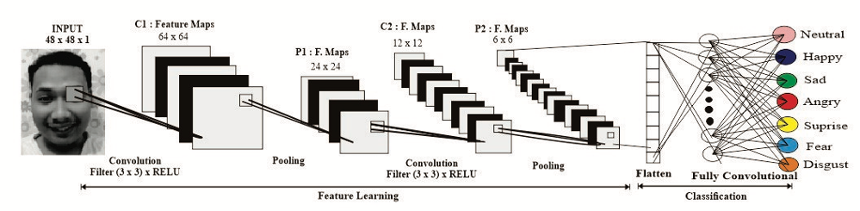
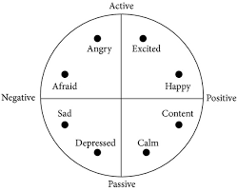
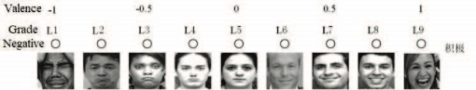
Related works
Facial Emotion Recognition Based on Convolutional Neural Network. (1)

Slide 13
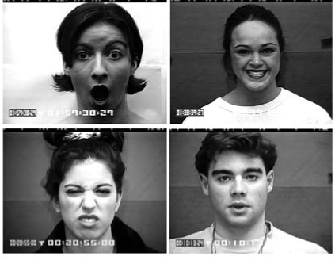
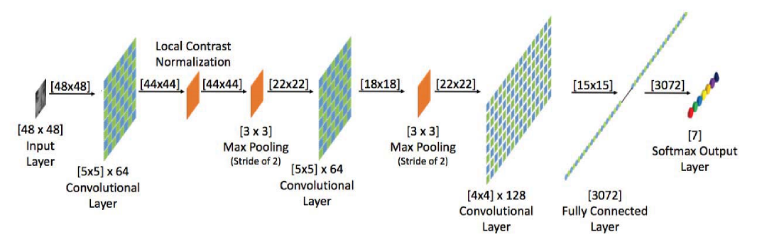
Related works [Contd.]
Content Based Facial Emotion Recognition Model using Machine Learning Algorithm. (2)

Slide 14
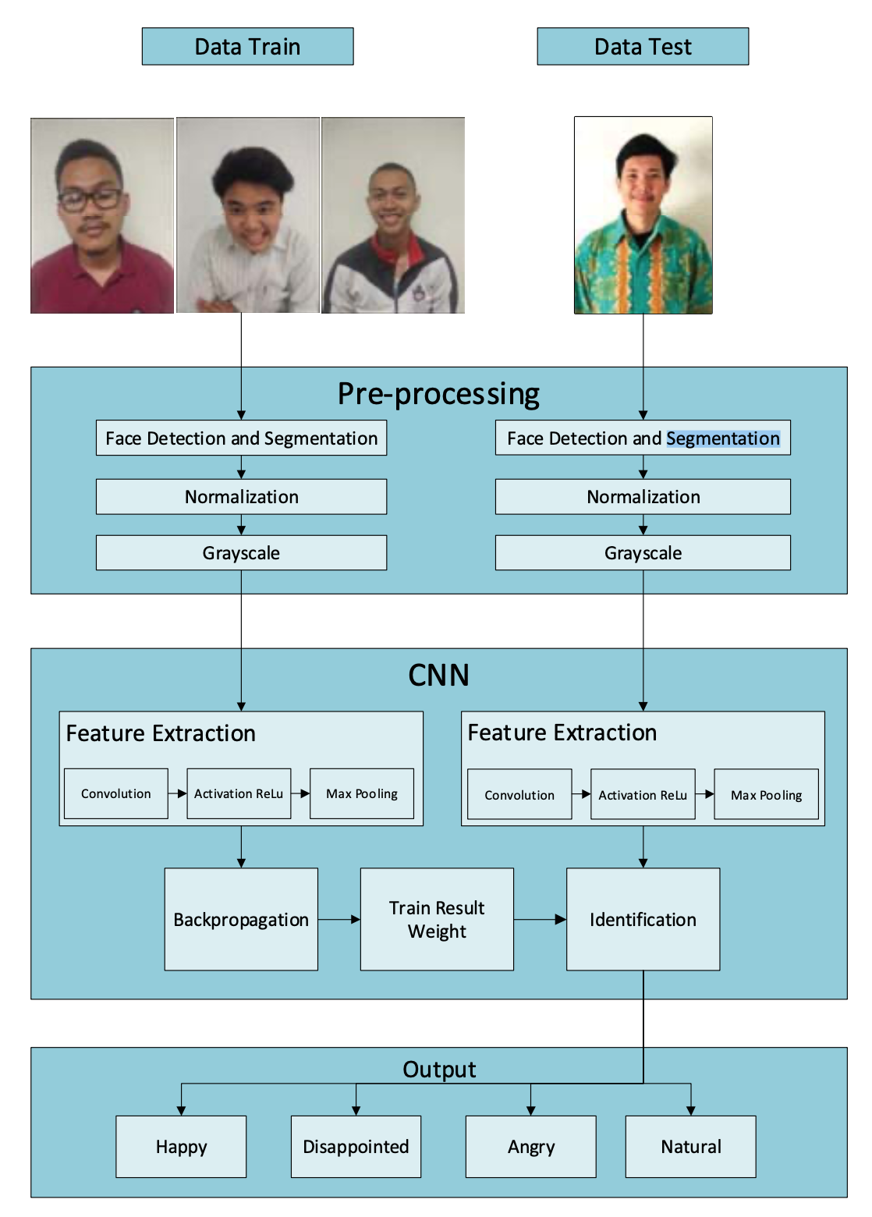
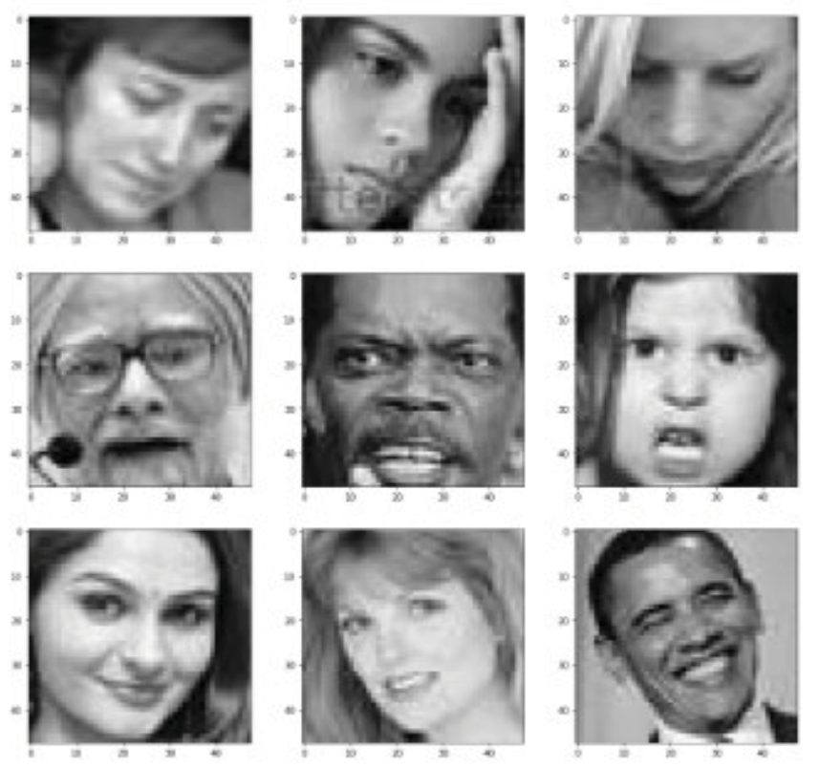
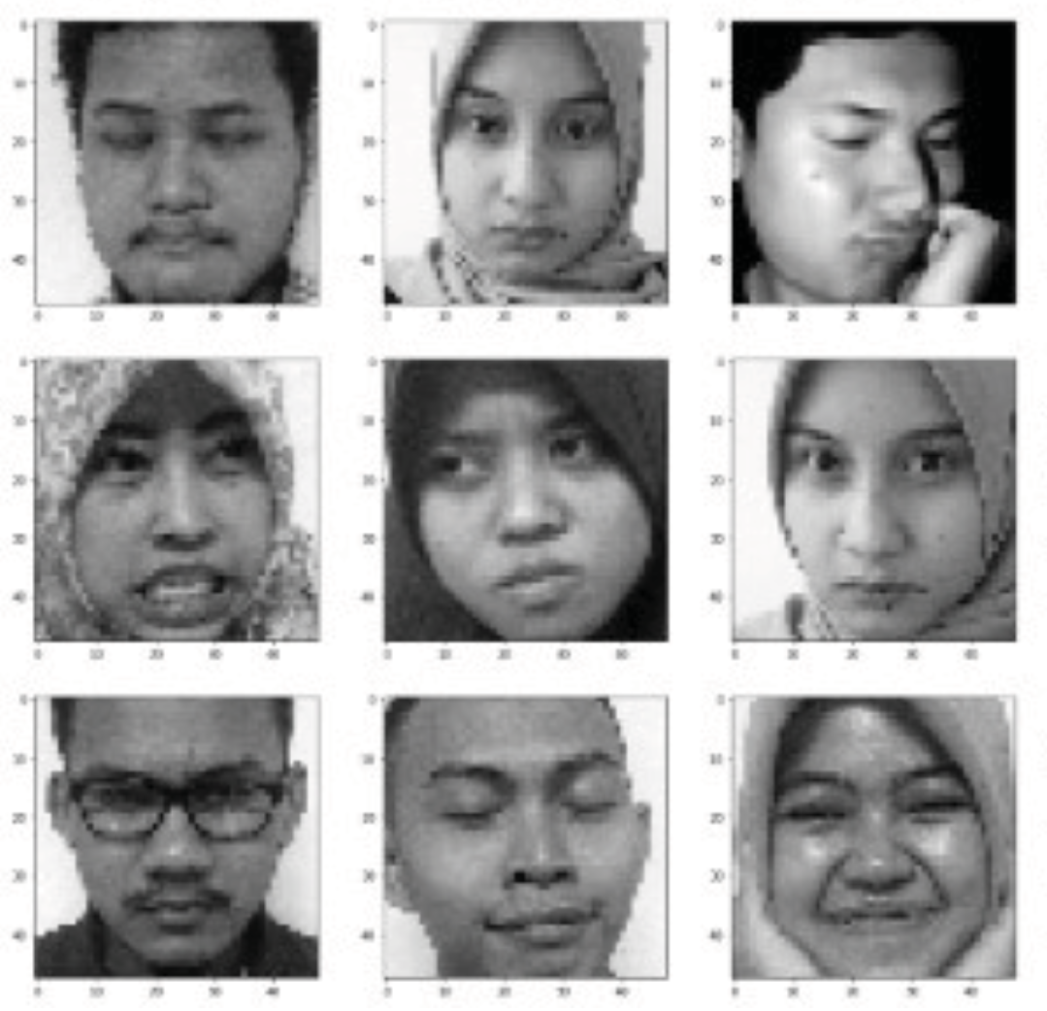
Related works [Contd.]
Convolutional Neural Networks Models for Facial Expression Recognition. (3)
FER – 2013 Dataset
Self-Created Dataset

Slide 15
5
System Workflow

Slide 16
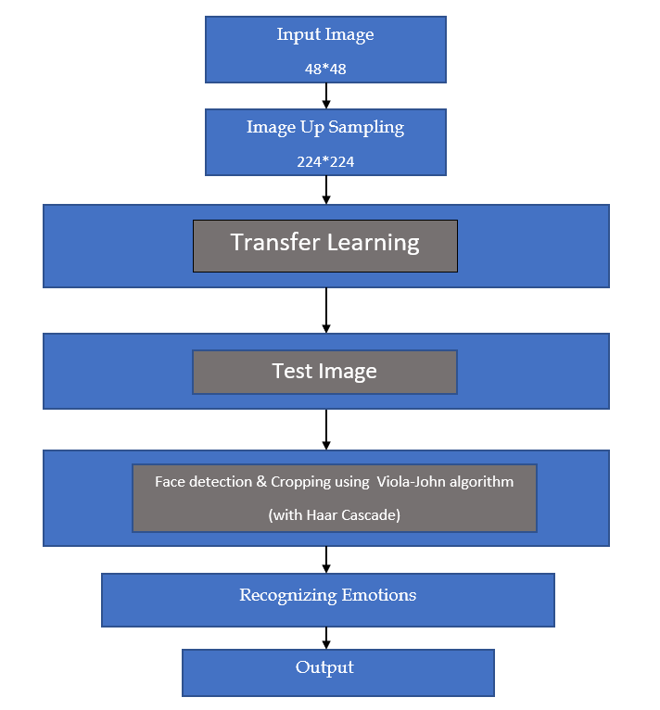
System Workflow

Slide 17
5
Datasets

Slide 18
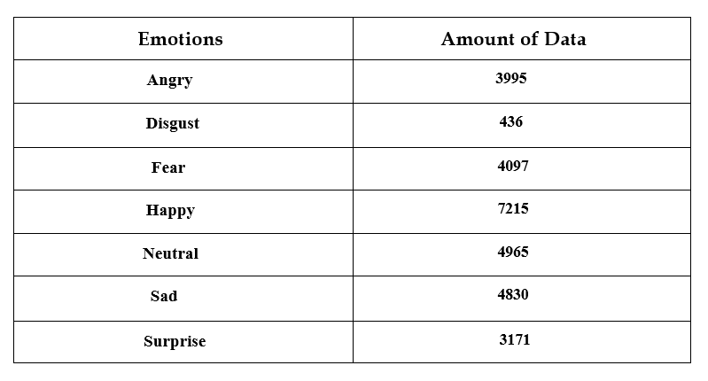

Dataset

Slide 19
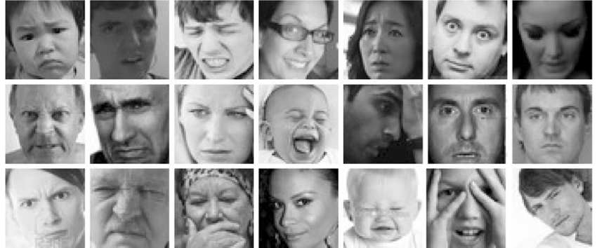


Dataset Sample
FER2013
Collected Dataset

Slide 20
6
Analyzing Images

Slide 21
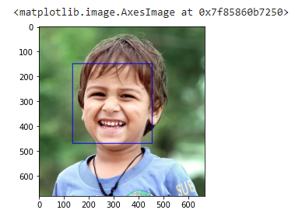
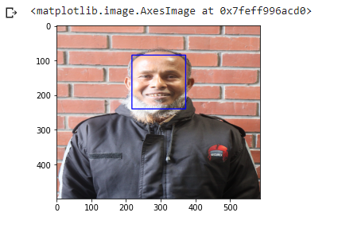
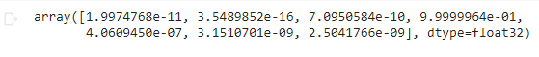

Recognizing Emotions

Slide 22
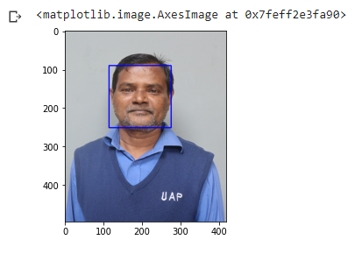
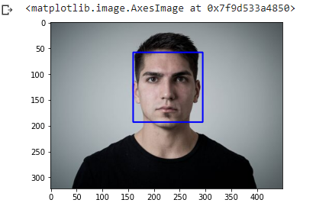

Recognizing Emotions

Slide 23
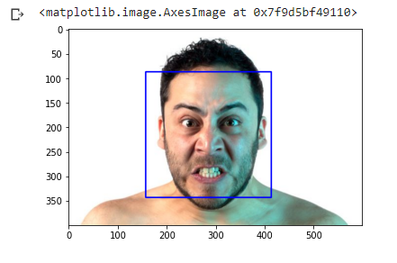
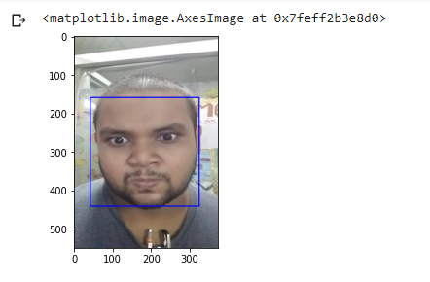

Recognizing Emotions

Slide 24
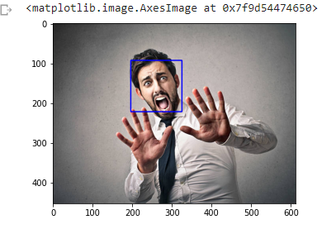
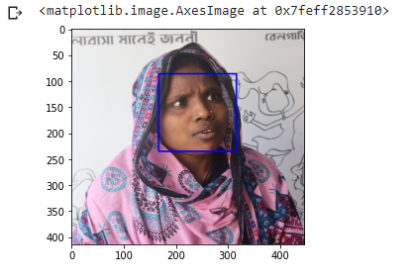
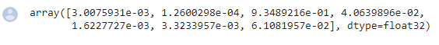
Recognizing Emotions

Slide 25
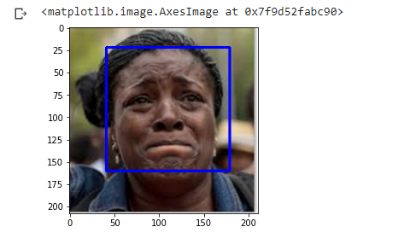
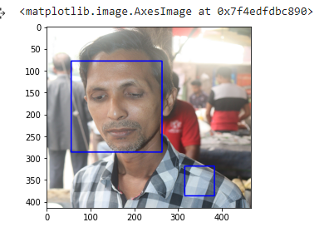
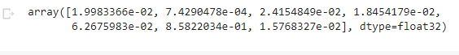
Recognizing Emotions

Slide 26
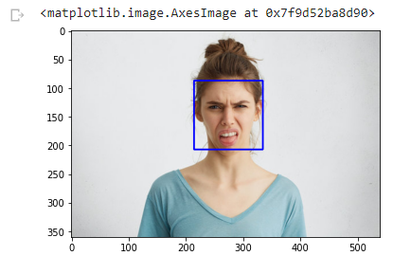
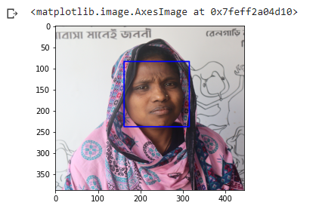

Recognizing Emotions

Slide 27
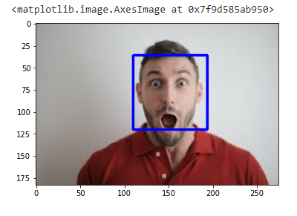
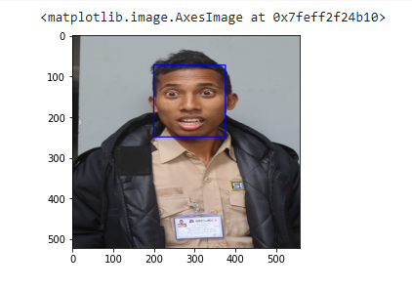

Recognizing Emotions

Slide 28
7
Result and Analysis

Slide 29
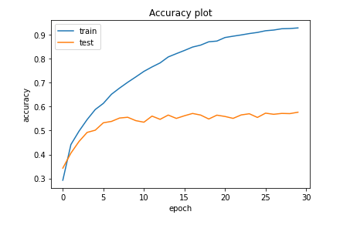
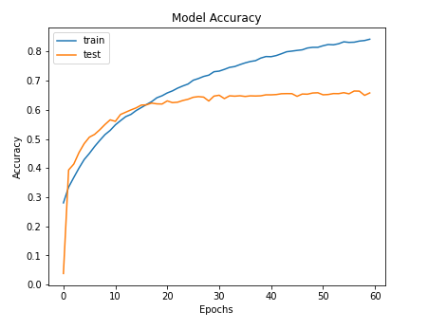
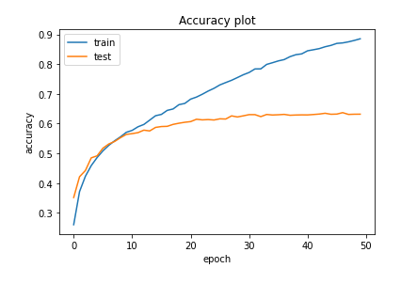
Analysis
Models | Accuracy
VGG-19 | 92.89%
ResNet-50V2 | 91.62%
MobileNetV2 | 92.76%
VGG-19
ResNet-50V2
MobileNetV2

Slide 30
8
Model statistics

Slide 31

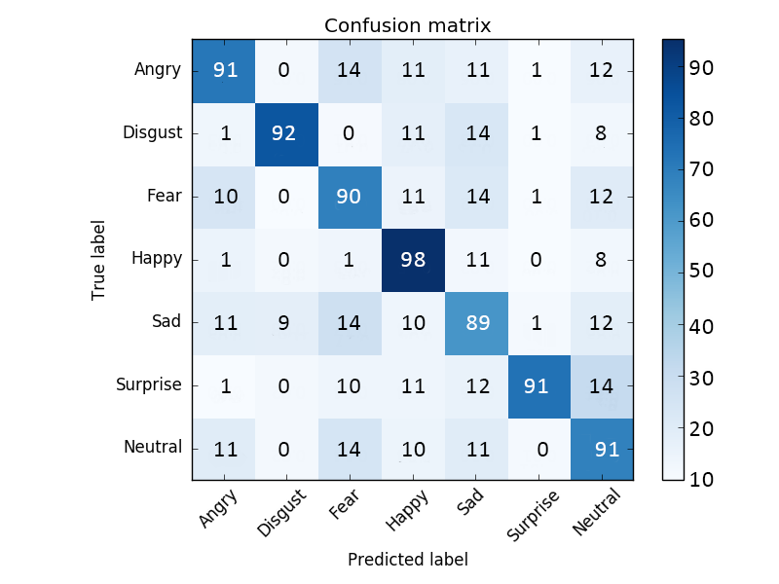
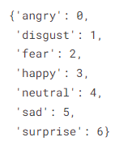
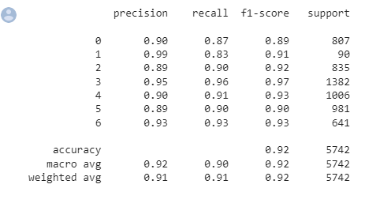
Model statistics (VGG-19)

Slide 32
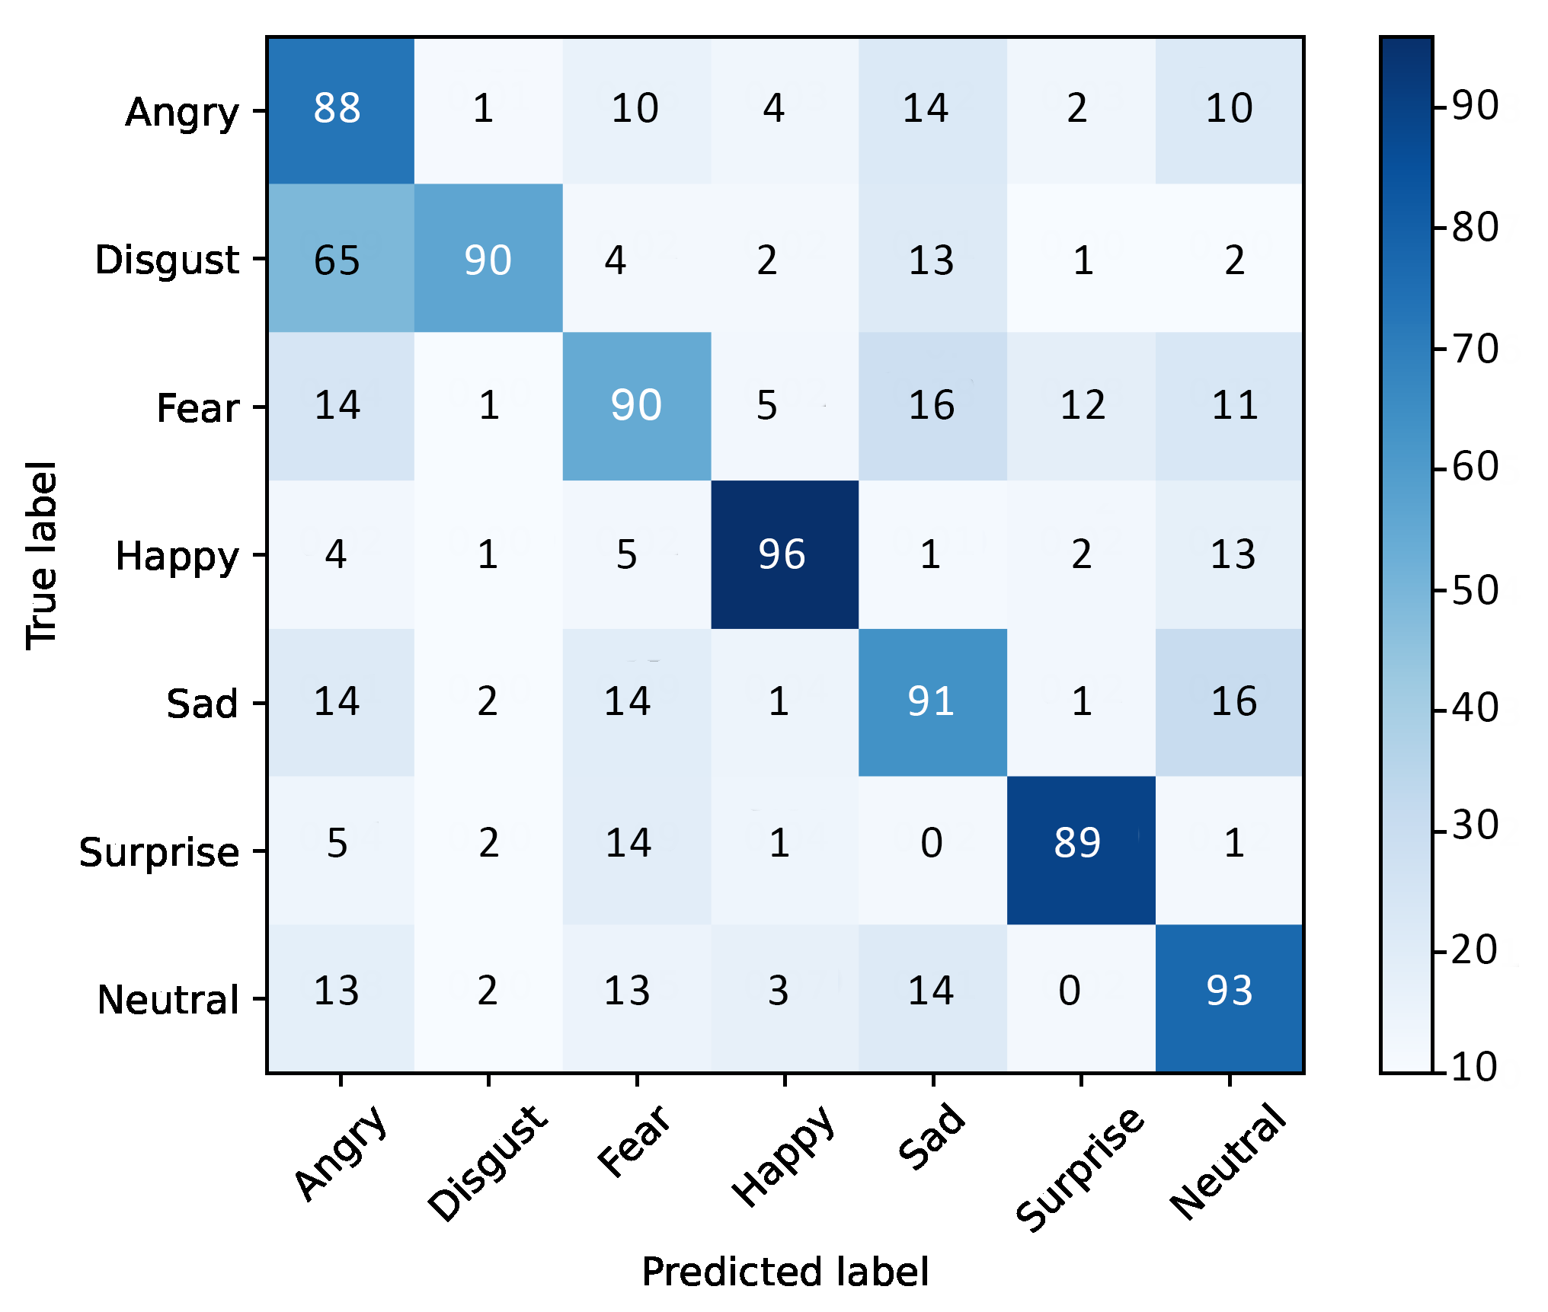
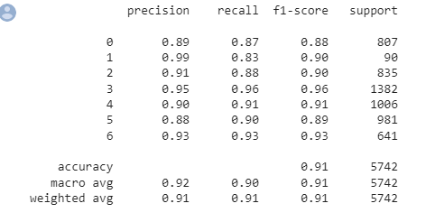
Model statistics (ResNet-50V2)

Slide 33
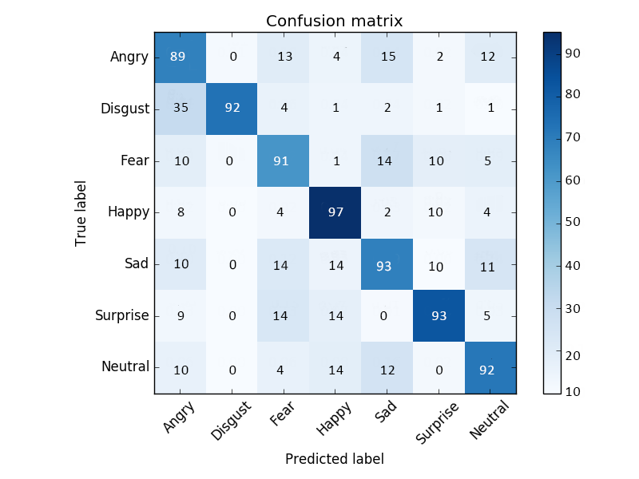
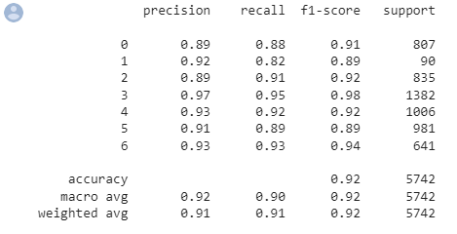
Model statistics (MobileNetV2)

Slide 34
9
Conclusion

Slide 35
Conclusion
We discuss the challenges faced by these systems and then analyze three Keras applications performance and accuracy. We test Bangladeshi people faces on our model and got good performance. The facial expression recognition system proposed in this research is based on the mapping of behavioral and physiological biometric factors and provides a strong face recognition model.

Slide 36
Future Work
We achieved an accuracy of around 92.89 % in our research, which is not terrible when compared to the previous models.
But we need to improve in specific areas like-
• number and configuration of convolutional layers
• number and configuration of dense layers
• dropout percentage in dense layers
We will also like to work on and compare neutral performance of three emotion recognition APIs namely Sightcorp, Kairos AR, SkyBiometry in future.

Slide 37
References
Shuang Liu, Dahua Li*, Qiang Gao and Yu Song, “Facial Emotion Recognition Based on Convolutional Neural Network”, in IEEE 2020 Chinese Automation Congress (CAC), 6-8 Nov. 2020
Ranjana.S.Jadhav, Premanand Ghadekar, “Content Based Facial Emotion Recognition Model using Machine Learning Algorithm.”, in IEEE 2018 International Conference on Advanced Computation and Telecommunication (ICACAT), 8-29 Dec. 2018
Burhanudin Ramdhani, Esmeralda C. Djamal*, Ridwan Ilyas, “Convolutional Neural Networks Models for Facial Expression Recognition”, in IEEE 2018 International Symposium on Advanced Intelligent Informatics (SAIN), 16-17 NOV. 2018

Slide 38
Thanks!
Any questions?

